Slide 2
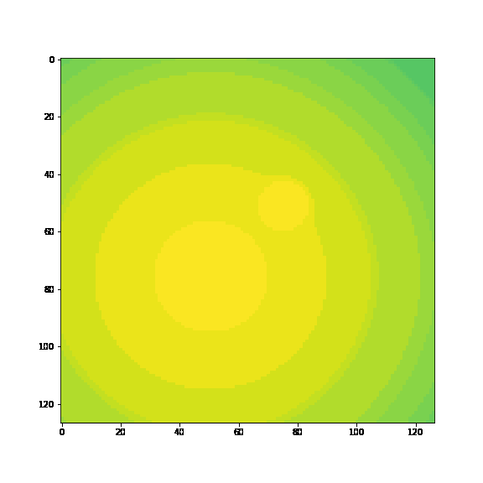
Multiscale in space and time. Toy1 is
2 times scales, 2 space scales

Slide 3
Having some trouble completely understanding MrCAE
How small should I compress down? It looks like Yuying’s code cuts in half every layer, toy1 has 3 layers. (smallest one he uses is 31x31 biggest 127x127)
I think I should start a lot smaller than this.

Slide 4
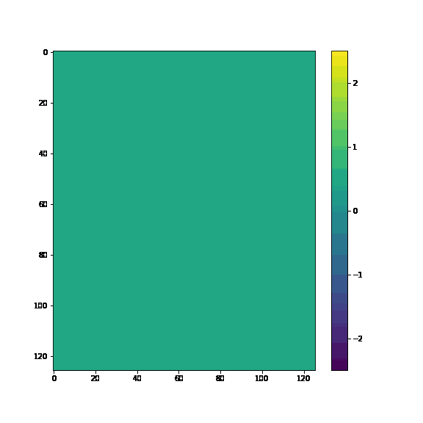
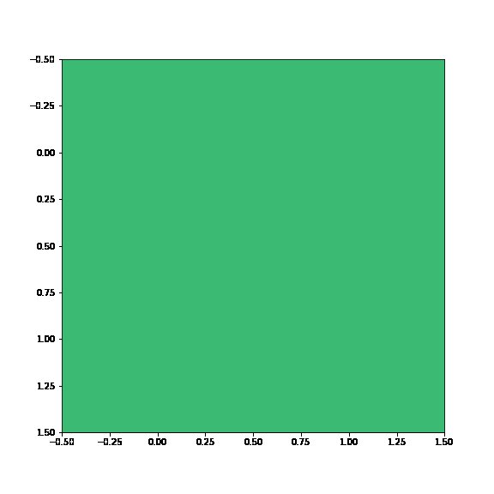
Using simple conv to predict to 2x2
Data on a 2x2 grid, these are the averages of each block

Slide 5
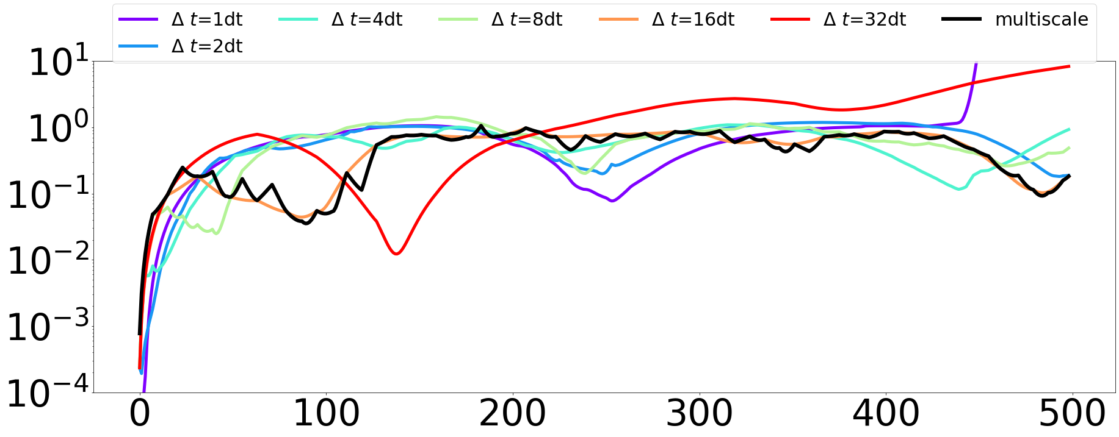
Predicting in time of a 2x2
Picked models 3 & 4
These are the error on the 2x2 not the whole system
2x2 data is using the average of each block

Slide 6
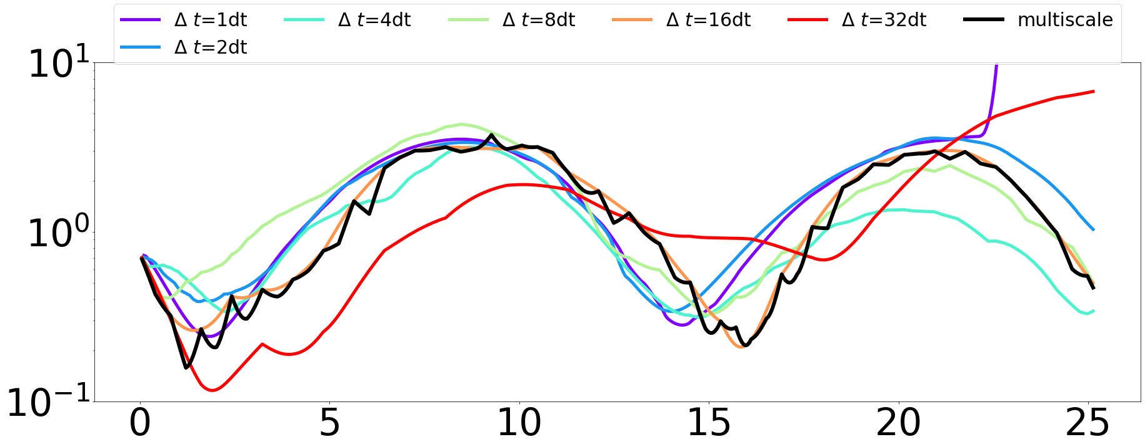
This is the error when we transform back to 126x126

Slide 7
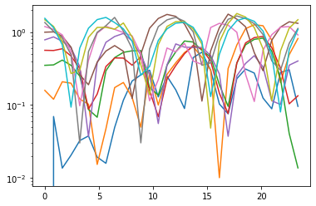
The 10 test runs (average of these is what’s in black in pervious slide ) 2x2

Slide 8
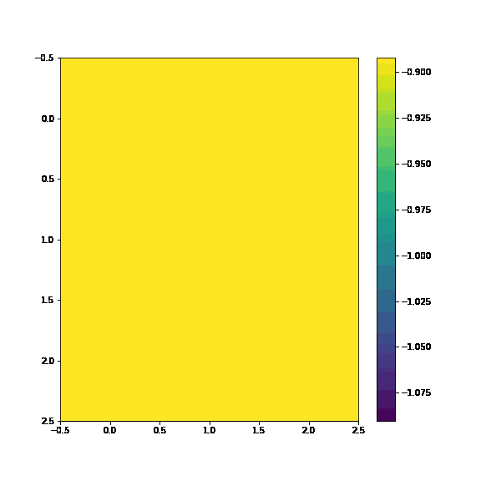
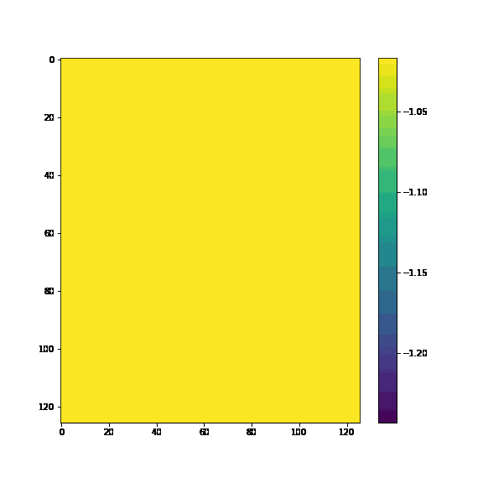
Also on 3x3
3x3 averages
3x3 simple autoencoder

Slide 9
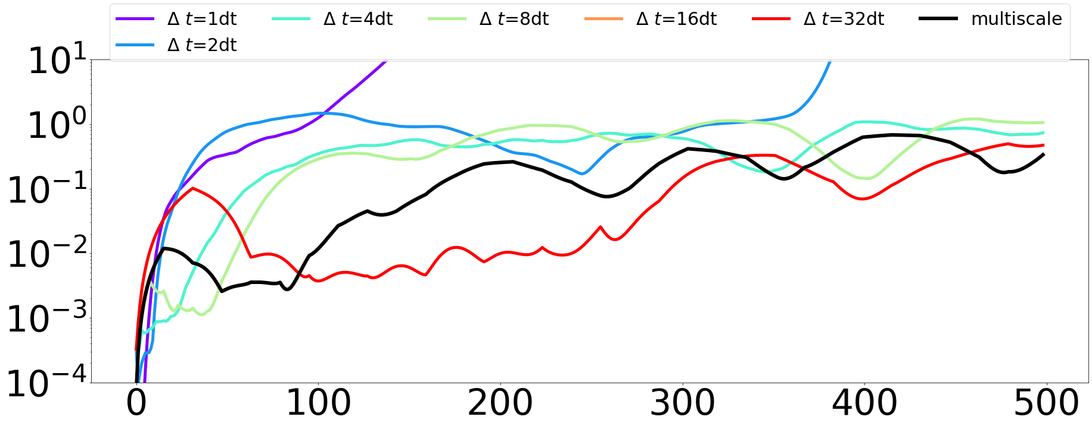
Predicting in time on a 3x3
Only picked model 4
The cross validation is only picking 1 timescale to use
3x3 data is using the average of each block

Slide 10
In MrCAE
In MrCAE, there are levels and stages.
For toy1, 3 levels, 4 stages per level:
archs = [[1,2,3,4],[1,2,3,4],[1,3,5,7]]
Levels are more refined,
But what are the stages?
We basically cut in half the areas that are still high error.

Slide 11
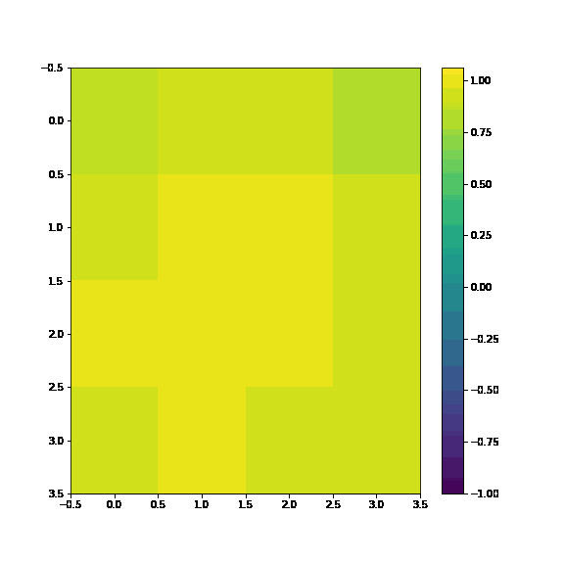
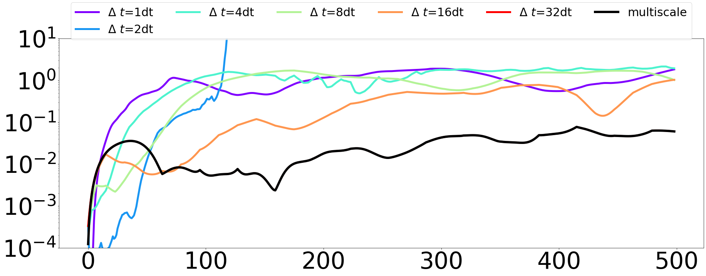
4x4 is also only picking largest time step

Slide 12
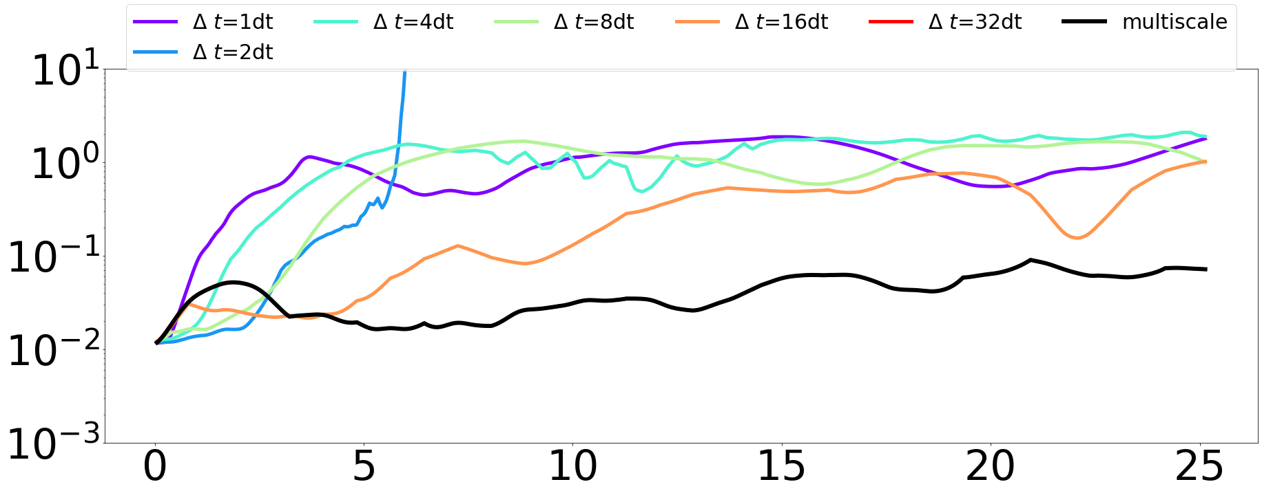
Error is 124x124 space

Slide 13
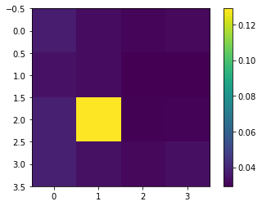
Average mse on 4x4

Slide 14
workflow
Make input dictionary like in active learning stuff
Need dt
Make data
Fit L0_0 autoencoder
Save encoded
Fit in time, use timestep with smallest error
First time check a bunch
After check current and next. If next is less error, check next of next until error goes up.
Save moved in time
Decode
Find error
Make map
Repeat 2-here for L0_*
Then we repeat 2-here with more levels

Slide 15
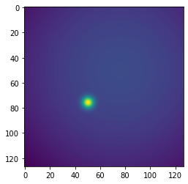
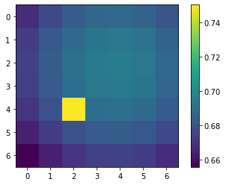
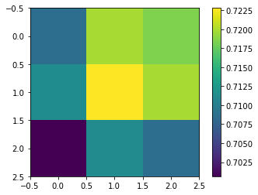
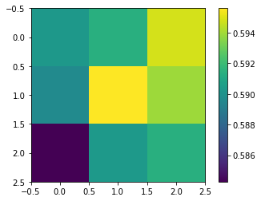
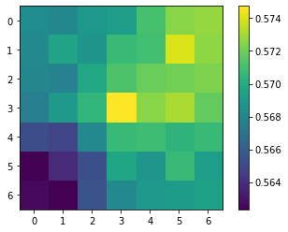
L0_0 with 500 timesteps
encoded
Truth full of last timestep
Through autoencoder of last timestep
Encoded predicted to last timestep
Predicted then decoded

Slide 16
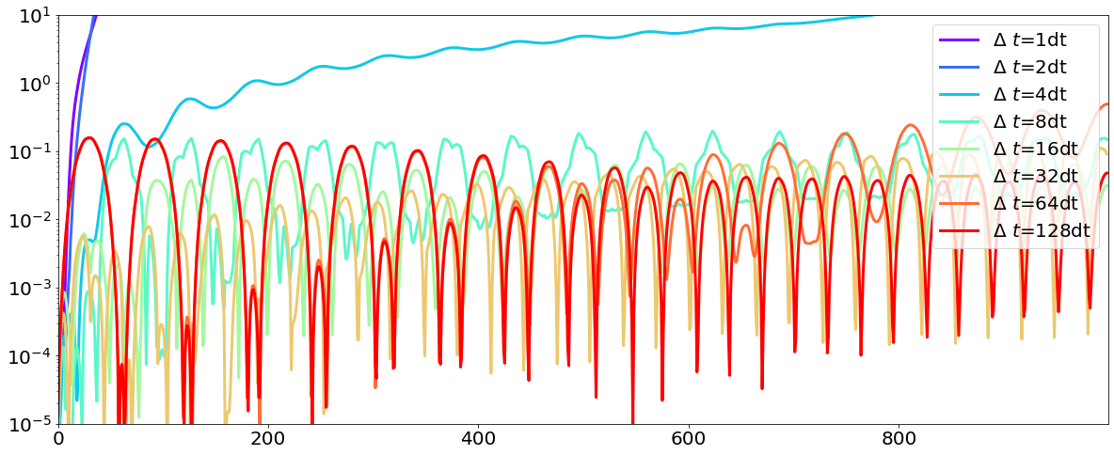
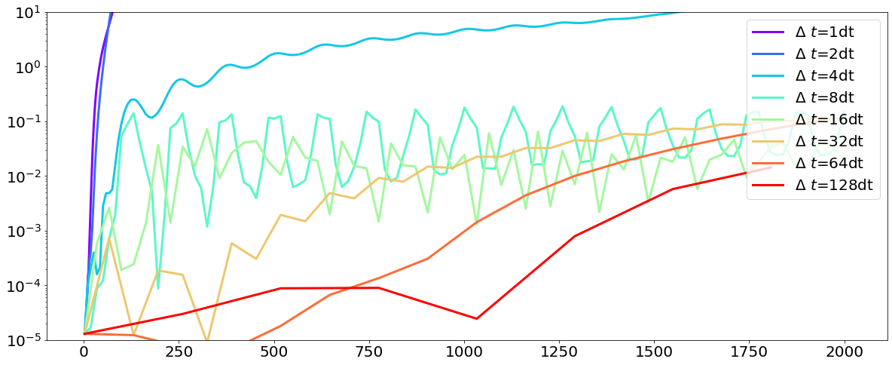
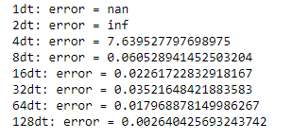
encoded moved in time L0_0
Comparing with the encoded 3x3. Is that a good way to do it? Or should I compare to whole system?
Using 128dt as timestep
Not interpolating between timesteps

Slide 17
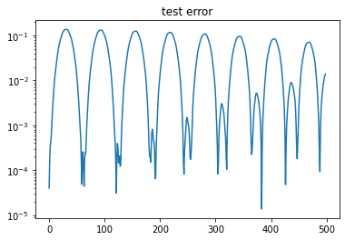
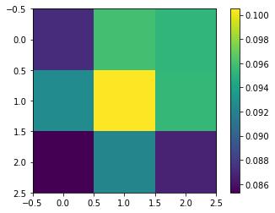
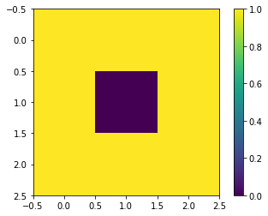
This is the test error on the decoded 7x7 as compared to the 7x7 input data
Pixel loss over the first 500 timesteps of training
With tol = 0.1
Resolve map

